Slide 1
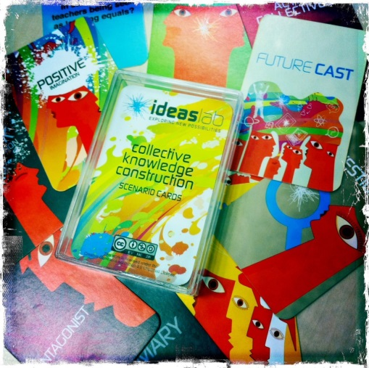
The Collective Knowledge Construction Scenario Game
The CKC Scenario Game is a card game adapted by ideasLAB* and designed to encourage and provoke both divergent and convergent thinking around collective knowledge construction. In this electronic presentation of the game you adapt it in any way you choose for presentations and team events, adding your own scenarios and rules.
For the rules of the card game version – visit http://www.ideaslab.edu.au/ckcgame/
For further information contact info@ideaslab.edu.au
www.ideaslab.edu.au
*“The Game” was originally developed by the INSTITUTE FOR THE FUTURE (http://www.iftf.org) and has been adapted by ideasLAB under Creative Commons. You are free to adapt and modify this game under the rules of Creative Commons – please acknowledge IFTF as the creators and ideasLAB as the adaptors of this game.

Slide 2
Alberta CoLab: Creative Commons Modifications on Future Cast
Based on the original Future Cast game design, Alberta CoLab has put together a printable, double-sided card deck for groups to use to play Future Cast.
While the original instructions and game design is accessible through the link on Slide One, what follows below is a set of tips and considerations for playing Future Cast that the Alberta CoLab team has found useful.
In this deck, you will find:
Future Cast Cards for double-sided printing:
Playing Cards
Summary Debrief Cards (Positive & Dark Summary Cards)
Future Cast Cards
Slides you may find useful when facilitating the game:
Game Overview
Instruction Slide
Summary Debrief Slide
Facilitation tips and suggestions

Slide 3
Facilitating the Game: Tips & Considerations
These are things, in our experience, we at Alberta CoLab have found work best. Make it your own!
Number of People: The game works best played in groups of 4-6 people. You can have multiple groups playing simultaneously off the same or different Future Casts.
Number of Cards: We suggest dealing each player 3 random cards per round.
Time: In our experience, plan for it to take 30 minutes to play one round (with debrief) with 6 people playing 3 cards each. Timing will also depend on the degree of conversation and the nature and purpose of the debrief.
Roles:
In each group, give one player the Positive Summary and another the Dark Summary card. Explain their roles to them.
Consider adding another role: Casting Director. This person helps keep the cards neatly mapped out as people play them. This person can also play a bit of group facilitation role and encourage people to explain their cards, rather than just playing them (i.e., Player: “That’s BS!” Casting Director: “What makes you think so?”)
Once folks get going and get how the game works, there isn’t a vital need for a group facilitator.
Process:
Consider generating the Future Casts around a particular question – ask the group what might a useful starting point for the conversation in advance of the session. It should be something relevant and interesting to them.
Use a brainstorming activity to generate Future Casts around a particular topic or question.
Agree on a timeline to help frame the conversation – how far in the future is it useful to talk about?
Outline what each card means up front – it helps people understand what they mean before they start.
Encourage the players to build a physical map of their conversation using the cards as they go.
Invite people to write a statement on a post-it and stick it to the Future Cast card they are playing – this helps everyone keep track of the conversation as they are playing and provides a useful reference for the debrief.
Invite people to play their cards based on any of the previously played cards – they do not have to play in a linear fashion and build on the last card played.
Remember to build in time for debriefing the game.

Slide 4
Facilitating the Game: Tips & Considerations – Cont’d
These are things, in our experience, we at Alberta CoLab have found work best. Make it your own!
Applications:
The game is originally designed to explore ideas about the future. However, other applications are possible; most notably policy and/or strategy development and assessment:
Start by formulating a problem in need of resolution (e.g., how might we fight climate change?)
Replace “Future Casts “ cards with “Ideas” cards, which people can use to offer potential answers to the problem. “Dark Imagination” cards should be reframed to ask, “what would make this idea fail?”; similarly, “Positive Imagination” cards should ask, “what would make this idea great? What would contribute to its success?”
People can contribute their potential answers by picking and filling an “Idea” card from a common pile.
Select ideas based on criteria that matter to you, such as magnitude of impact.
Play the game starting from one Idea card.

Slide 5
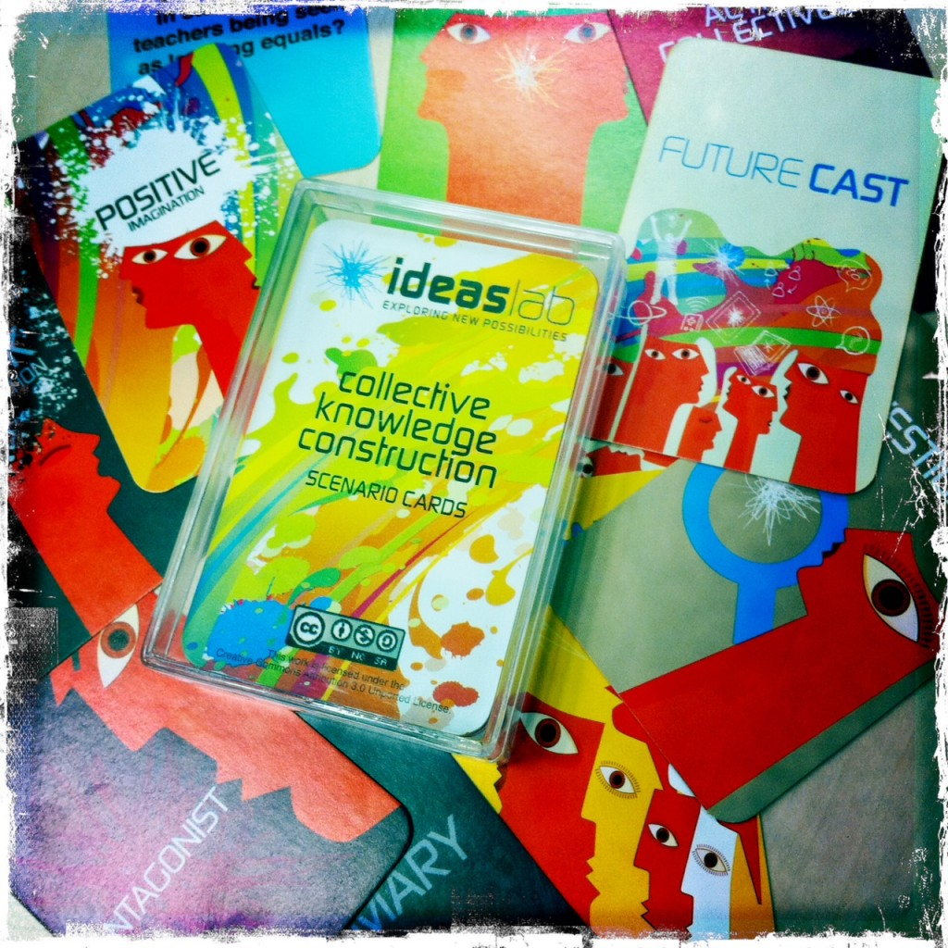
Future Cast: Exploring Possible Futures
Future Cast: The Collective Knowledge Construction
Scenario Game
Designed to:
Generate shared understanding
Encourage and provoke both divergent and convergent thinking
Explore options & futures
Notes:
SALVA

Slide 6
Remember!
Be creative – entertain ideas beyond what you may believe to be possible right now.
Be bold – assume that you can:
Access any resource needed
Remove any obstacle
Change any practice
Collaborate across any boundary
How to Play:
Goal: to be as creative a thinker as possible when faced with different Future Casts, to entertain ideas that may adversarial to current paradigms, and to think of alternate positions and implications.
As a group, choose one Future Cast to explore.
Deal three random cards per person.
Players with a Positive/Dark Summary card should identify themselves – they will need to keep track of the positive or negative imagination arguments and summarize them at the end of the round.
Positive = benefits of the future cast & arguments why it may come true
Dark = disadvantages of the future cast & arguments against it coming to be
Explore the Future Cast using the cards.
The first player to the left of the dealer with a Positive or Dark Imagination card goes first.
The round continues until players have played all their response cards.
Notes:
SALVA

Slide 7
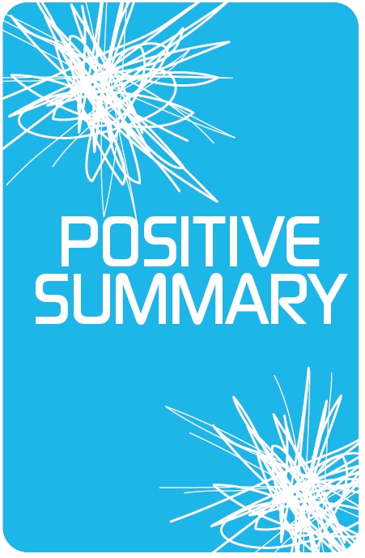
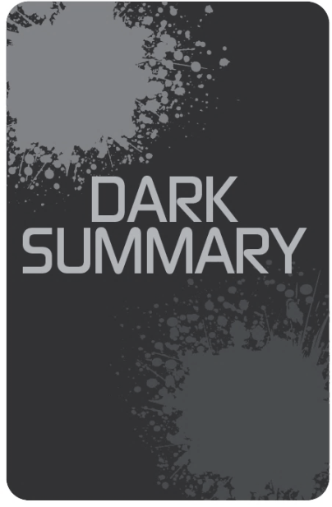
Notes:
SALVA
Game Debrief – Findings:
Positive Summary
Negative Summary
ROYA
Game Debrief – Method:
What was it like exploring the issue in this way?
Does this differ from how you would normally explore a topic? How so?

Slide 8
What would make this future cast impossible?
What would make this future cast impossible?

Slide 10
What would make this future cast possible?
What would make this future cast possible?

Slide 12
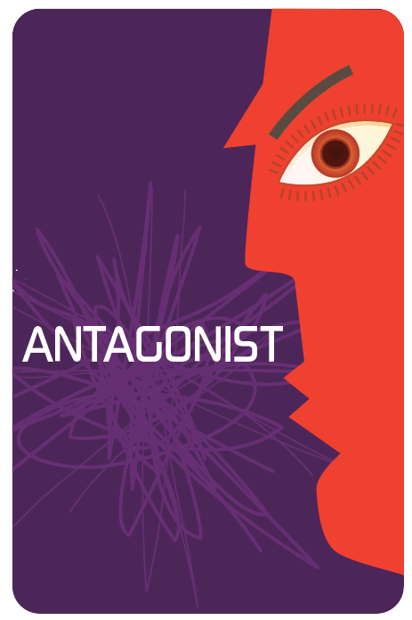
I disagree. Here’s what I think might happen:
I disagree. Here’s what I think might happen:

Slide 14
Ask or answer a follow-up question.
Ask or answer a follow-up question.

Slide 16
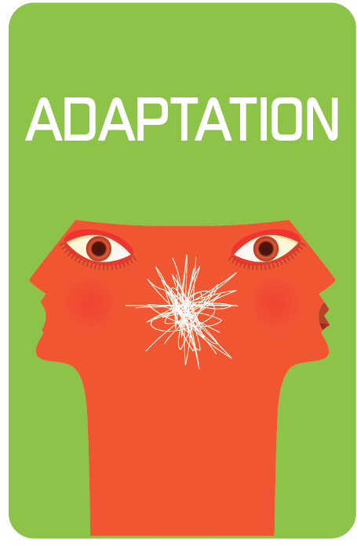
This is how I think this might this play out differently:
This is how I think this might this play out differently:

Slide 18
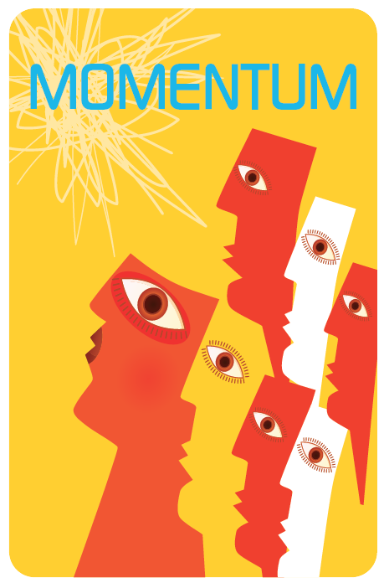
If that scenario happens, what happens next?
If that scenario happens, what happens next?

Slide 20
Keep track of the positive arguments. You will summarize them at the end of the round.
Keep track of the positive arguments. You will summarize them at the end of the round.

Slide 22
Keep track of the negative arguments. You will summarize them at the end of the round.
Keep track of the negative arguments. You will summarize them at the end of the round.

